Slide 1



Slide 2
Accounting Forms

Slide 3
Accounts Payable Checks

Slide 4
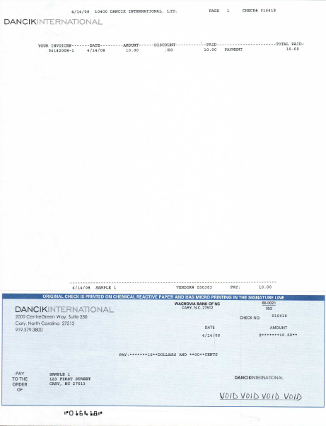
Laser – Pre-Printed Check Stock

Slide 5
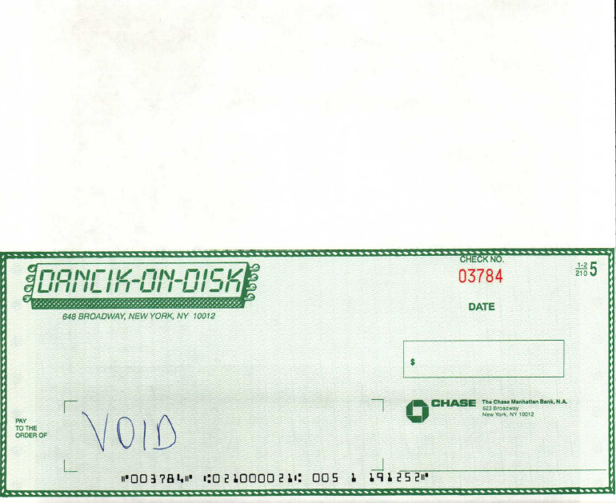
Form Fed-Dot Matrix Check Stock

Slide 6
Accounts Payable Checks
Dancik offer’s two form options for printing checks. Options include a laser format preprinted check form and a impact printer preprinted check form in which multiple copies are generated thru multi-part paper.
Laser pre-printed check forms are typically more economical, as well as offer a larger section for remittance which results in less spoilage. If the remittance area is not large enough to list all invoices being paid, the system will roll to the next page and continue with remittance. One of the two checks will be flagged as “Void.”
As an alternative, some customers utilize a 3rd party software solution for printing check stock which eliminates the need for pre-printed forms. An example of a 3rd party software is Secure Check www.securecheck.com. **Dancik does not endorse or warranty any of these 3rd party software applications.
Setup for Check Forms
Controlled at the user control panel file

Slide 7
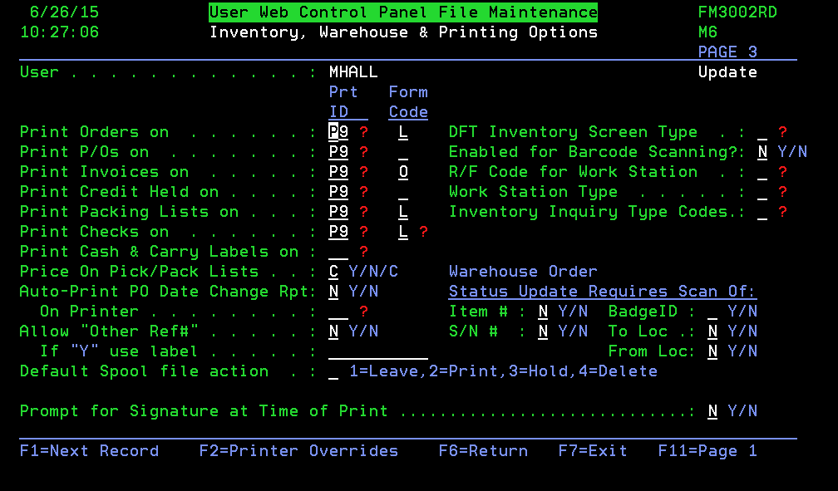
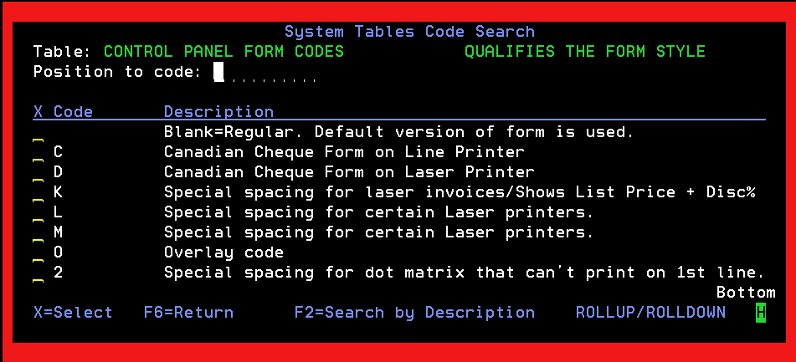
NAV 5

Slide 8
Invoices

Slide 9
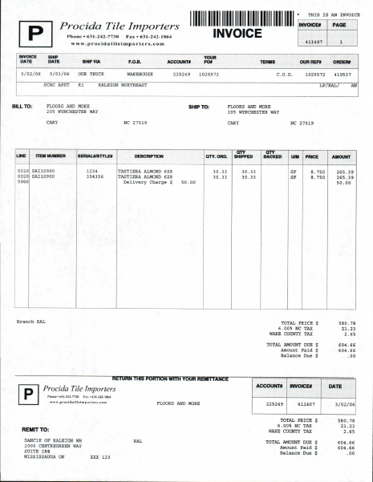
Laser Invoices with Overlay and Logo*
*Requires IPDS print capability

Slide 10
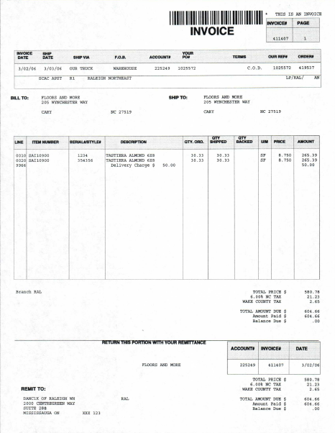
Laser Invoice Format with Overlay-No Logo*
*Requires IPDS Print Capability

Slide 11
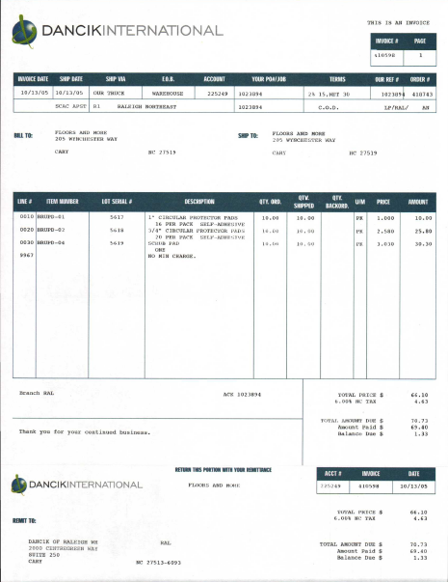
Laser Invoices with Pre-Printed Forms

Slide 12
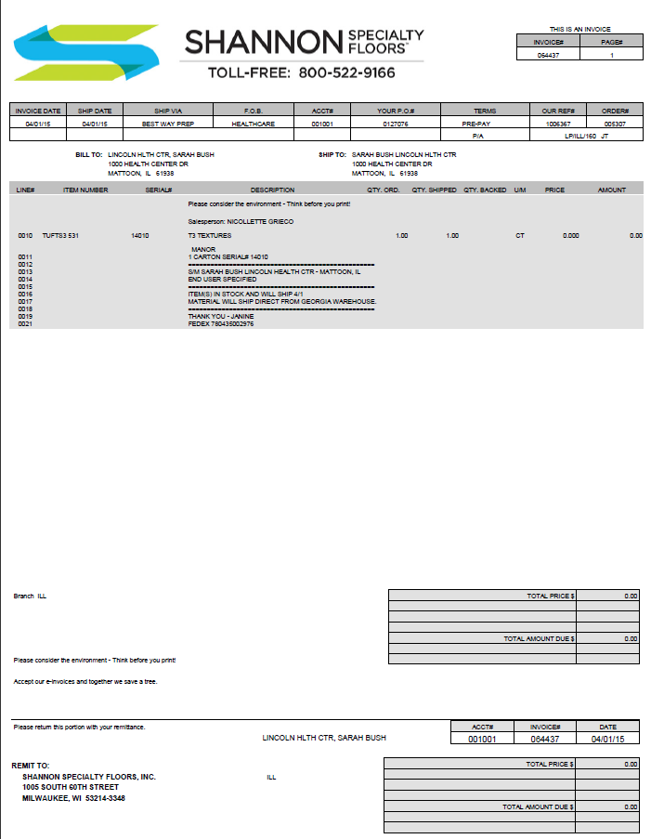
Emailed Invoices with Style Sheets and Logo

Slide 13
Invoices
Dancik offers several form options for printing invoices. Options include a laser format preprinted invoice form, laser format invoices using an overlay (requires printer with IPDS capabilities), landscape format for impact printers and a special format for emailing utilizing style sheets which offer more flexibility.
Laser formats using overlays is the most economical method. If your organization chooses to have logos printed, Dancik will load these logos for you as part of your implementation hours while in the implementation phase. If you wish to have Dancik load these logos after you are fully implemented, please contact Dancik’s Professional Services Team.
Setup for Printing Invoices
Controlled at the user control panel file
NAV 5
Laser Invoices – Pre-printed forms – Use form code L
Laser Invoices – Overlay –Use form code O
Note: You may need to go into the F2 printer overrides and adjust some offsets, depending on your printer models. This is a trial and error to offset margins depending on different printer drivers.

Slide 14
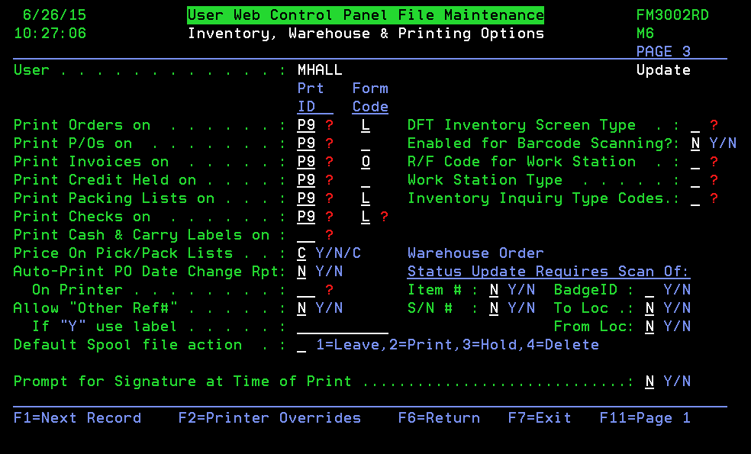
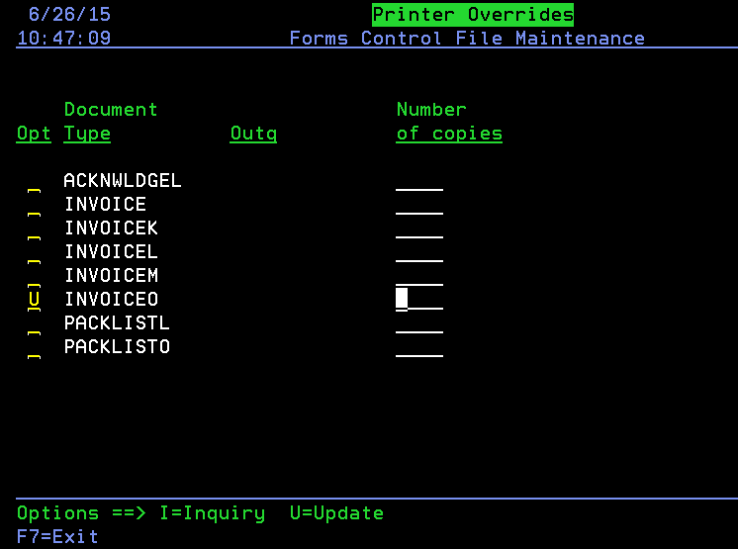
NAV 5
Form Code: L= Laser, O = Overlay

Slide 15
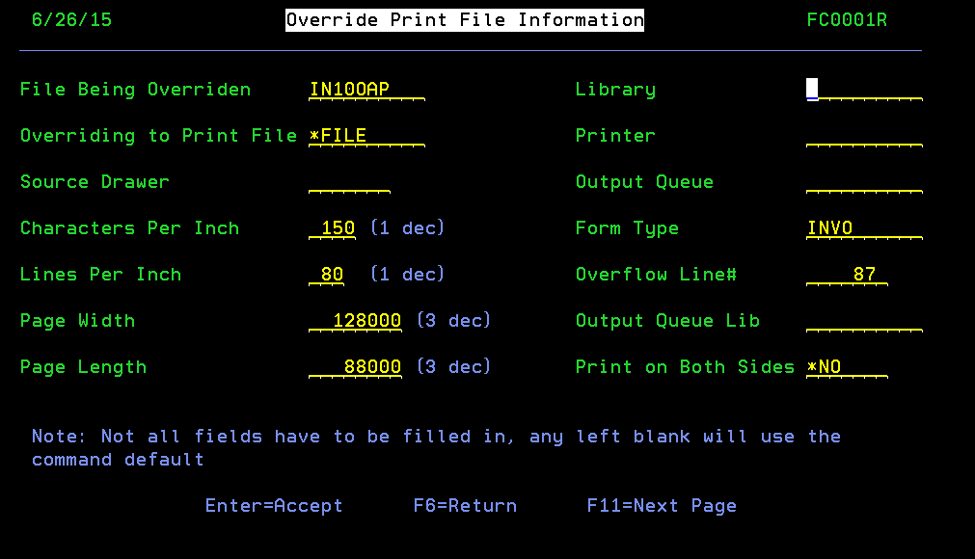
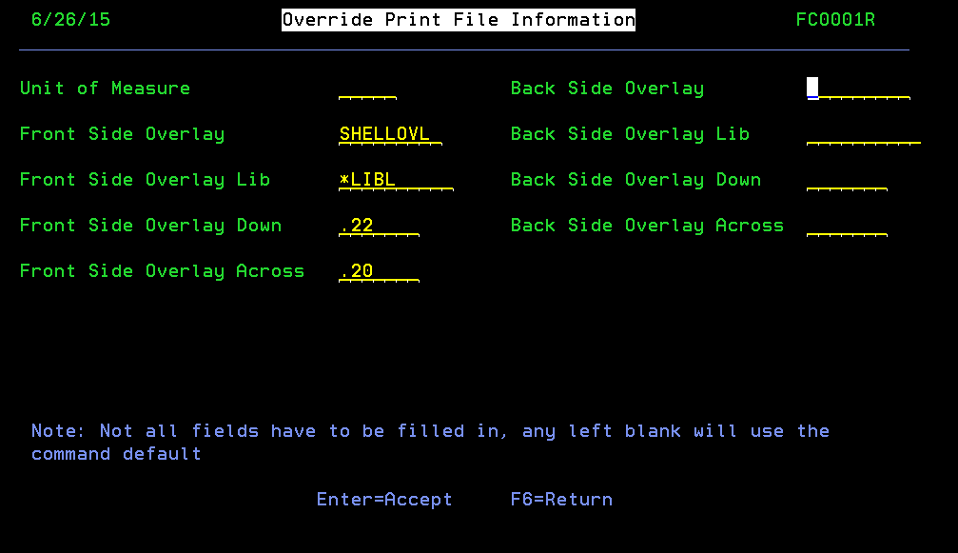

Slide 16
Accounts Receivable Statements

Slide 17
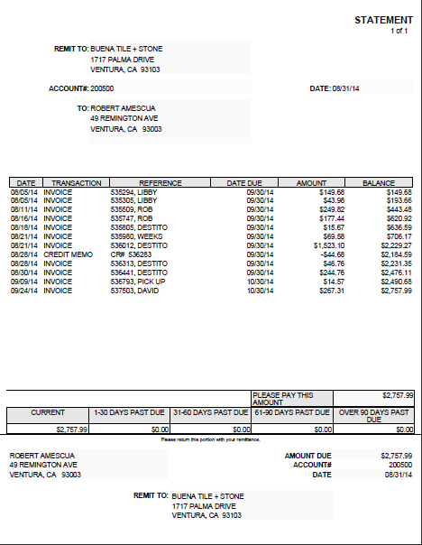
Laser Statement Overlay without Logo

Slide 18
Laser Statement Overlay with Logo

Slide 19
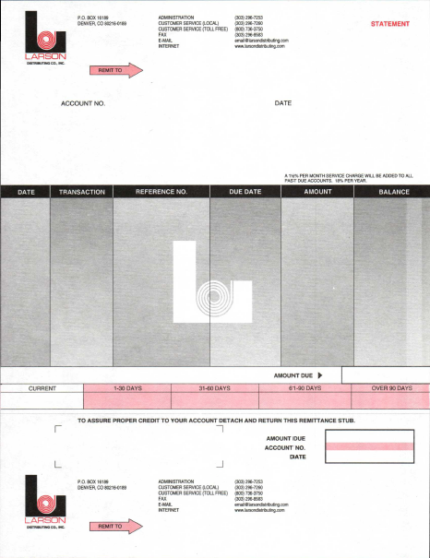
Laser format Statements with Pre-Printed Forms

Slide 20
Accounts Receivable Statements
Dancik offers two form options for printing Accounts Receivable Statements. Options include a laser format preprinted statement form, and a laser format statement using an overlay (requires printer with IPDS capabilities).
Laser formats using overlays is the most economical method. If your organization chooses to have logos printed, Dancik will load these logos for you as part of your implementation hours while in the implementation phase. If you wish to have Dancik load these logos after you are fully implemented, please contact Dancik’s Professional Services Team.
Setup for AR Statements
Controlled Systems Settings
SET 4
Laser Invoices – Pre-printed forms – Use form code L
Laser Invoices – Overlay –Use form code O
Note: You may need to go into the F2 printer overrides and adjust some offsets, depending on your printer models. This is a trial and error to offset margins depending on different printer drivers.

Slide 21
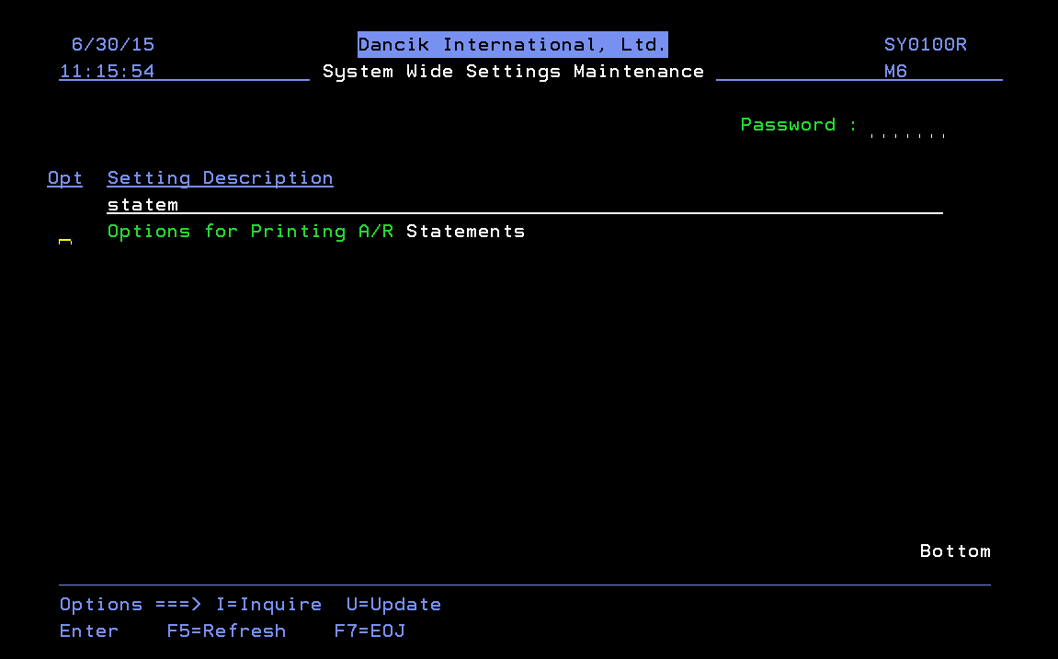
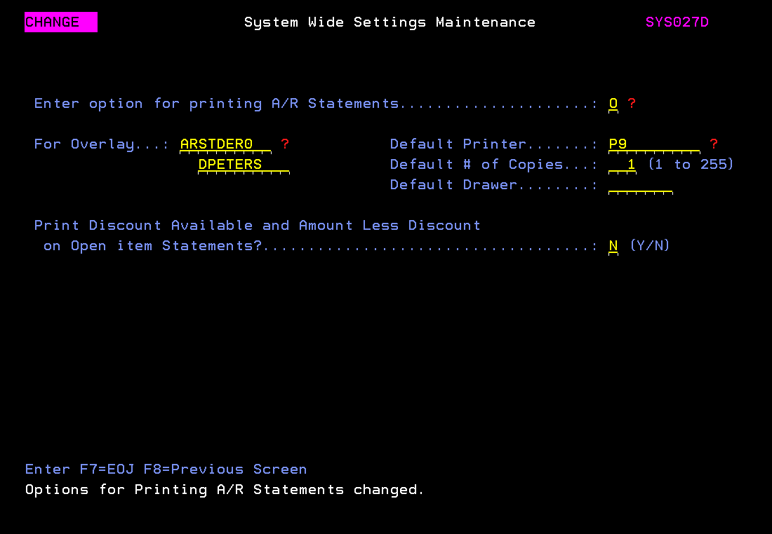
SET 4
Form Code: L= Laser, O = Overlay – You will be provided the code for the overlay with your company specific logo

Slide 22
Customer Service

Slide 23
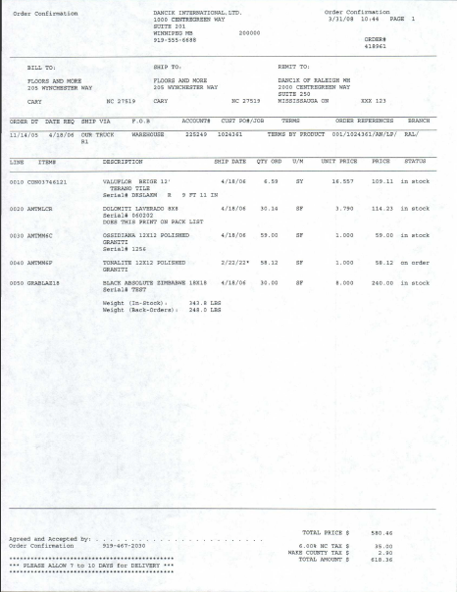
Order Confirmation/Acknowledgement

Slide 24
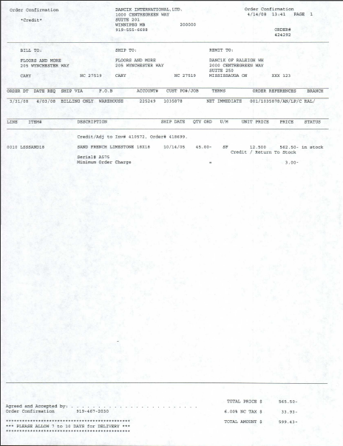
Order Confirmation/Acknowledgement – Credit Memo

Slide 25
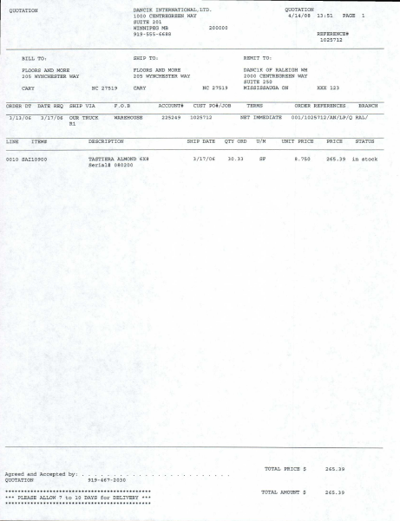
Quotation

Slide 26
Order Acknowledgements/Quotes
Dancik offers two form options for printing customer documents such as Order Acknowledgements and Quotes. Options include a laser format in portrait direction, and a dot matrix version in landscape direction in which you may use an impact printer and get pre-printed forms.
Laser formats using overlays is the most economical method. Logo’s and updating styles are not yet available for laser formats.
If you prefer to utilize impact printers, ask your implementation specialist for examples
Setup for Order Acknowledgements
Controlled at User Control Panel
NAV 5
Form Code L= Laser

Slide 27
Purchasing

Slide 28
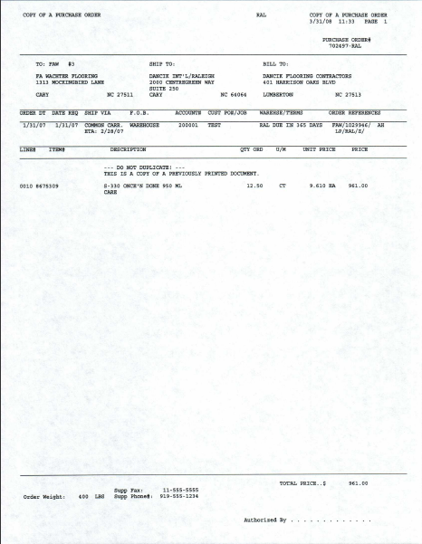
Laser Format Purchase Order

Slide 29
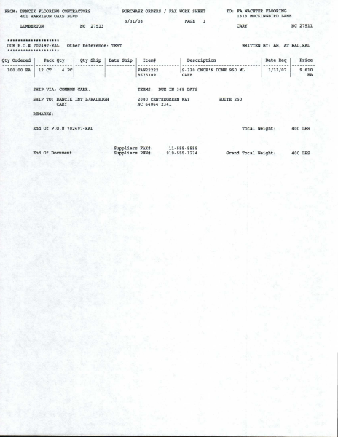
Purchase Order Faxable Worksheet

Slide 30
Order Acknowledgements/Quotes
Dancik offers two form options for printing Purchase Orders. Options include a laser format in portrait direction, and a dot matrix version in landscape direction in which you may use an impact printer and get pre-printed forms.
Laser formats using overlays is the most economical method. Logo’s and updating styles are not yet available for laser formats. If you wish to utilize impact printers, please ask your implementation specialist for examples.
Setup for Order Acknowledgements
Controlled at User Control Panel
NAV 5
Form Code L = Laser

Slide 31
Receiving Documents

Slide 32
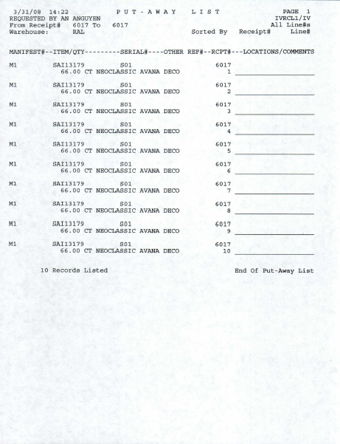
Receiving Put-Away-List

Slide 33
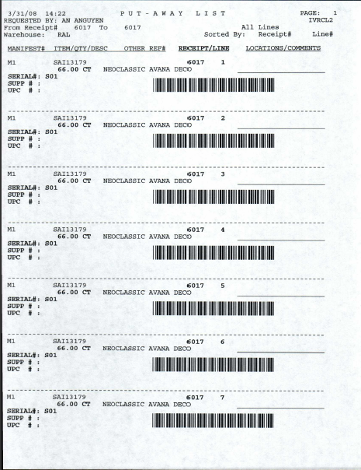
Receiving – Put-Away-List with Barcodes*
Requires Printer with IPDS capability

Slide 34
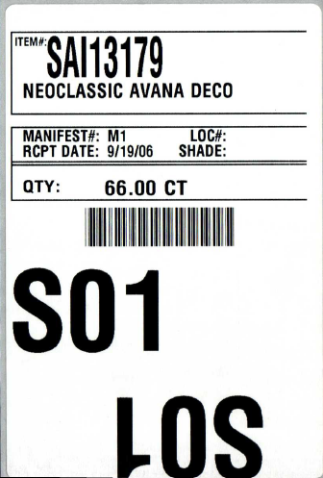
Serial Labels

Slide 35
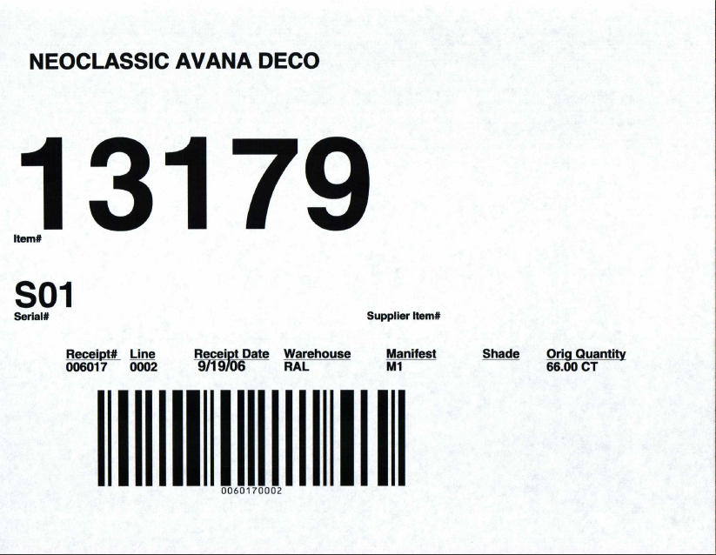
Serial Number Tag with Barcode*
Barcodes require Printer with IPDS Capability
8.5 x 11 paper

Slide 36
Shipping Documents

Slide 37
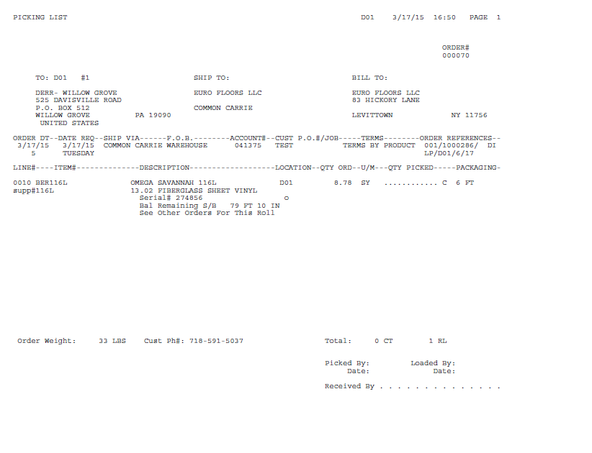
Pick Tickets – Laser Format
Print Landscape

Slide 38
Pick Tickets – Laser Format
Print Portrait

Slide 39
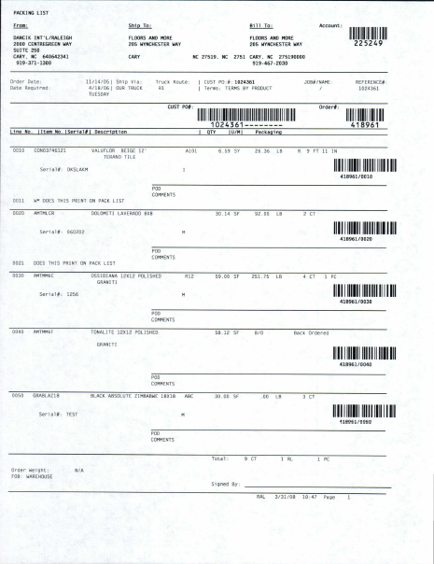
Laser Packing List with Barcodes

Slide 40
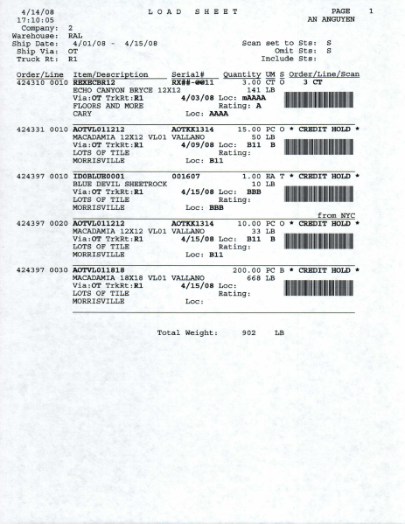
Load Sheet with Barcodes*
Requires Printer with IPDS Capability

Slide 41
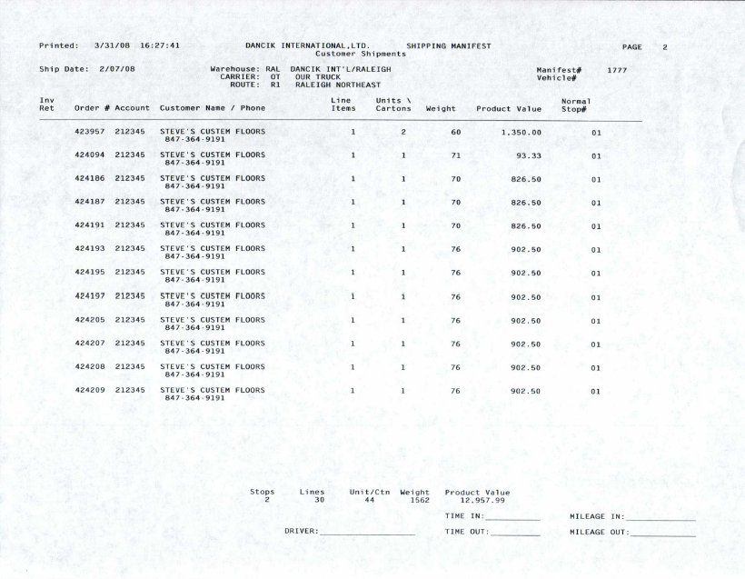
Shipping Manifest – Prints Landscape

Slide 42
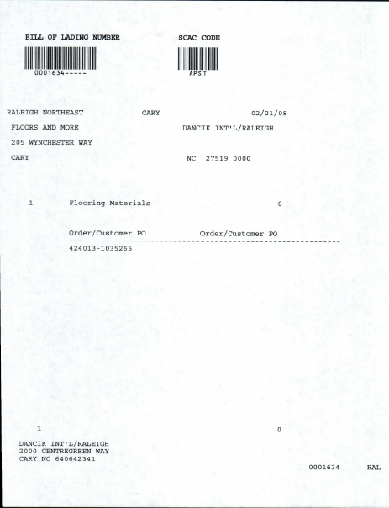
Bill of Lading

Slide 43
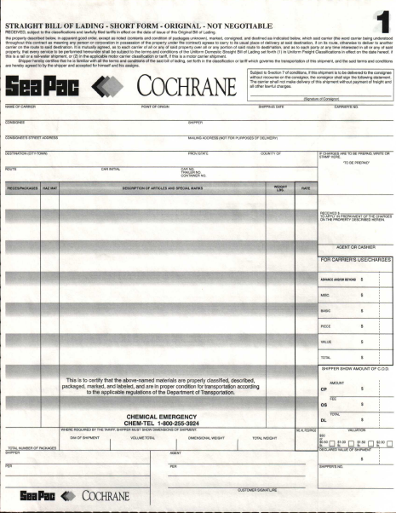
Pre-Printed form Bill of Lading

Slide 44
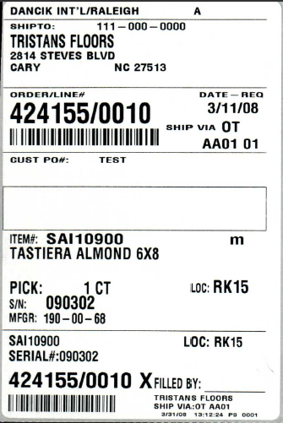
Customer Shipping Labels

Slide 45
